Slide 1
Today’s world requires speed on each and every field. Hence rapidness and quick working is the most important. Nowadays for achieving rapidness various machines are manufactured by man. The engineer conformed to the challenges of bringing ideas,design in to reality. New machines and techniques were developed to manufacture various products at cheaper rates and high quality. The mechanism “GEARLESS POWER TRANSMISSION” is designed and manufactured for being compact and to transmit the power without any gears.
ABSTRACT

Slide 2
Engineer is constantly conformed to the challenges of bringing ideas and design in to reality. The project “GEARLESS TRANSMISSION” being compact and portable equipment. It transmits power at right angle without any gears being manufactured. The parts can be easily made and price is also less. The Cylinder-piston Mechanism transmits the input power towards the output side.
INTRODUCTION

Slide 3
In such a way that the angular forces produced in the shafts are simply transmitted with the help of cylinder-piston. The mechanism which takes up the input power and the angle drive is transferred towards the output power shafts and Cylinder-piston assembly. Hence very little friction plays while the power is being transmitted. Therefore, it is appreciated that efficiency as high 90-92% is possible in Gear-Less Transmission mechanism.

Slide 4
Here is a wonderful mechanism that carries force through a 90º bend. Translating rotational motion around an axis usually involves gears, which can quickly become complicated, inflexible. So, instead of using gears, this technology elegantly converts rotational motion using a set of cylindrical bars, bent to 90º, in a clever,simple and smooth process that translates strong rotational force even in restricted spaces.
DESIGN AND FABRICATION

Slide 5
A gearless transmission is provided for transmitting rotational velocity from an input connected to three bent links. Both the input shaft and the housing have rotational axis. The rotational axis of the input shaft is disposed at an angle of 90 degrees with respect to the rotational axis of the housing. As a result, rotation of the input shaft results in a processional motion of the axis of the bent link. The rotary and reciprocating motion of bent link transmit rotation of prime mover to 90 degree without any gear system to an output shaft without gears. The transmission includes an input shaft.

Slide 6
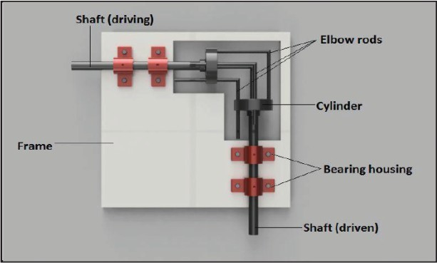
DIAGRAM

Slide 7
The Gearless transmission or Cylinder-piston mechanism is a device for transmitting Motions at any angle between the driving and driven shaft. This whole assembly is mounted on welded MS base. The working of the mechanism is understood by the diagram. An unused form of transmission of power on shaft located at an angle. Motion is transmitted from driving shaft to the driven shaft through the rods which are bent to conform to the angles between the shafts. These rods are located at the holes equally spaced around a circle and they are free to slide and shaft revolves.
WORKING

Slide 8
This type of drive is especially suitable for the operation at high speed is essential but only recommended for high duty. The operation of this transmission will be apparent by the action of one rod and in making this transmission, it is essential to have the holes for a given rod located accurately in the same holes. It must be equally spaced in radial and circumferential directions, be parallel to each rod should be bent to at angle at which the shaft is to be located. The driving shaft rotates the power is transmitted by the driven shaft and it is the working of this mechanism.

Slide 9
Drive Shaft Bearing Housing Driven Shaft Cylinder Elbow rods Frame
PARTS

Slide 10
More efficient than gear. Ease of manufacturing. Misalignment of shafts can be tolerated to some extent. Low cost of manufacturing. It is easily portable.
ADVANTAGES

Slide 11
Does not work at very low starting torque. Links are to be replaced after certain cycle time. Speed ratio is always constant 1:1.
LIMITATIONS

Slide 12
Pump and motor setup at 90 degrees. Conveyors, Steering column and its systems. Small machineries,etc..
APPLICATIONS

Slide 13
This projects looks very simple and easy to construct and very difficult to conceive and imagine without seeing an actual one in practice. It is an event fact in the creative mental process not the forces, which predominate among the schemes of the active tinkers. This mechanism hence we are mould to present this our project gear-less transmission at 180˚(Cylinder-piston mechanism) which we have managed to successful device input in conceiving its working principle.
CONCLUSION

